Slide 1

Master Thesis Presentation
Simulation Environments & AI-based Autonomous Driving Solutions
-a Comparative Evaluation
Mahesh Saravanan
Supervised by
Prof. Dr. Christian Bachmeir
Mr. Leon Heller
Notes:
This thesis has been divided into two parts

Slide 2
Contents
Introduction
Comparative study
Parameters
Generative model based simulators
Results
Notes:
A comparative study and the process of development of prototype simulator

Slide 3
Autonomous Driving
Introduction
Introduction
Comparative study
Parameters
Generative model based simulators
Results
Autonomous driving involves a driving assistance system that can fully or partially operate a vehicle.
These systems utilize various sensors to perceive the environment, and the vehicle is guided by decisions made by intelligent algorithms.
Autonomous driving has diverse applications. The Society of Automotive Engineers (SAE) drafted a 6 level classification for autonomous vehicles based on their level of autonomy, ranging from basic driving assistance to full self-driving capabilities.
Level 0 | Level 1 | Level 2 | Level 3 | Level 4 | Level 5
No Automation | Driver Assistance | Partial Automation | Conditional Automation | High Automation | Full Automation
Taxonomy of Driving Automation Systems for On-Road Motor Vehicles
Notes:
Not necessarily self driving cars but some assistance system like ADAS falls under this category.
Applications

Slide 4

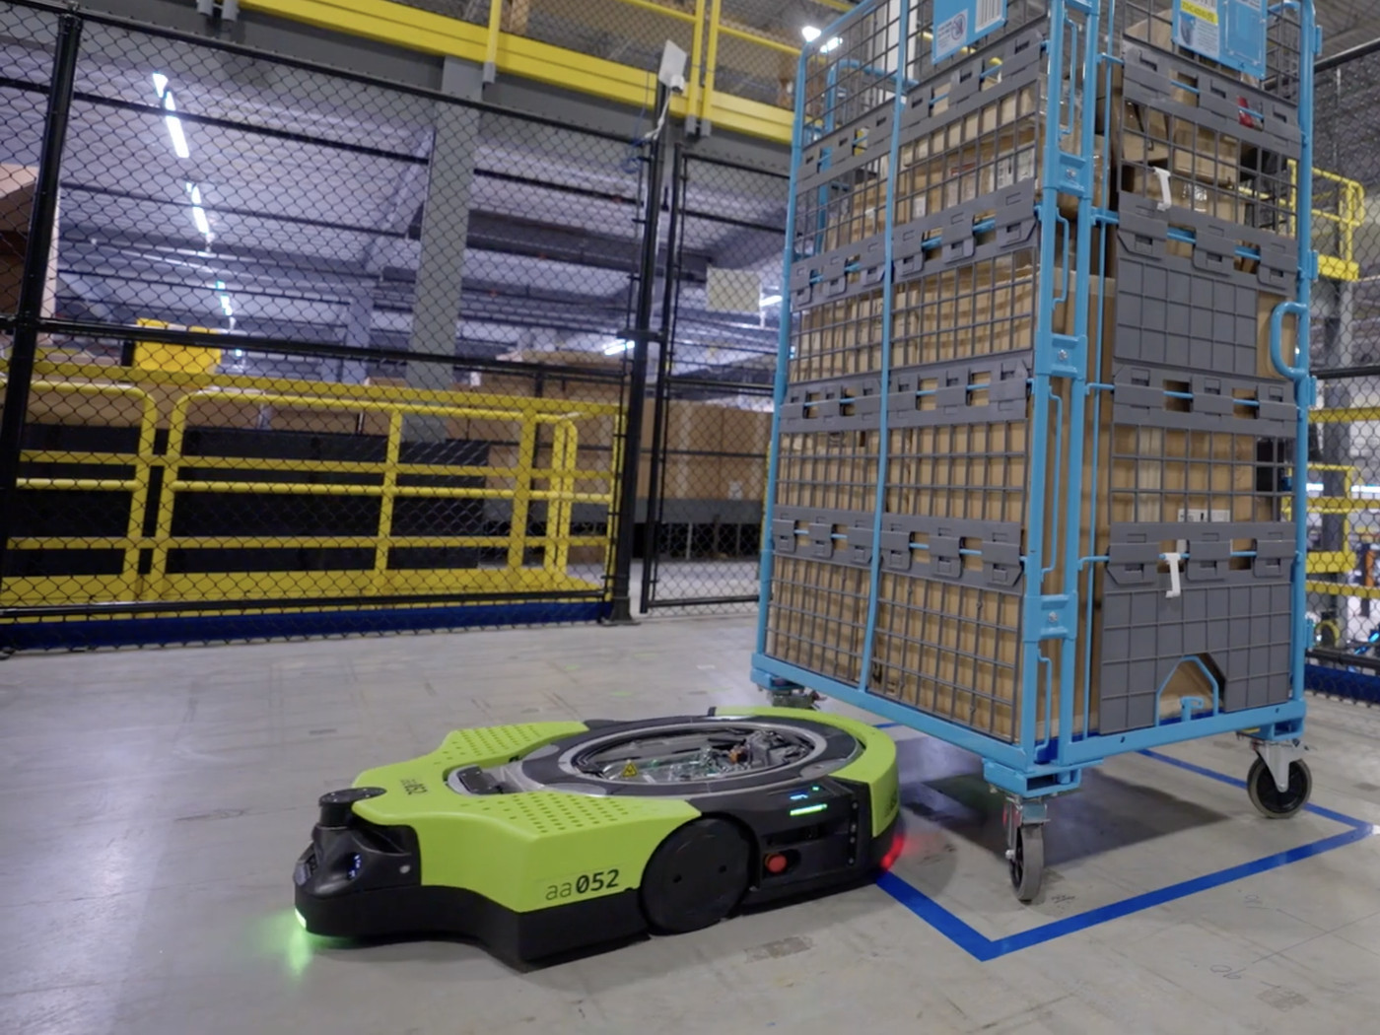
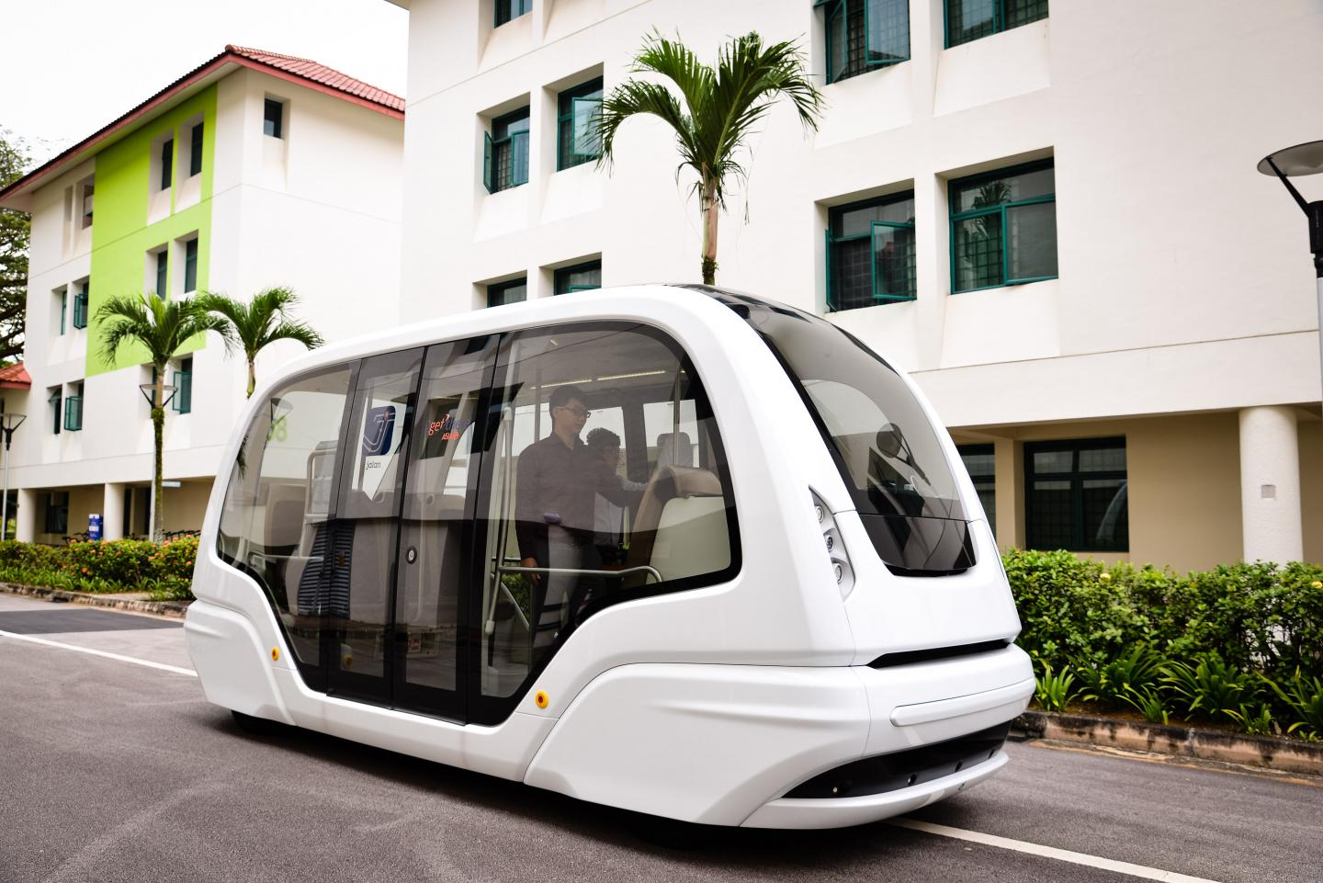
Autonomous Driving- Applications
Introduction
On Road Autonomous Taxi
Warehouse autonomous robot
In campus shuttle vehicle

Slide 5
Simulators
Introduction
Simulators replicate real-world scenarios, enabling exploration of diverse scenarios more efficiently.
They are utilized across various applications, ranging from microbiology to outer space research.
Why simulators in Autonomous driving?
Cost and Time Efficiency: Training in real-world settings is costly and time-consuming.
Versatile Learning: Simulators enable training in diverse driving scenarios.
Safety : Testing in simulators is safer compared to real-road testing.
Notes:
Software that mimic a real world system.
Desert example

Slide 6
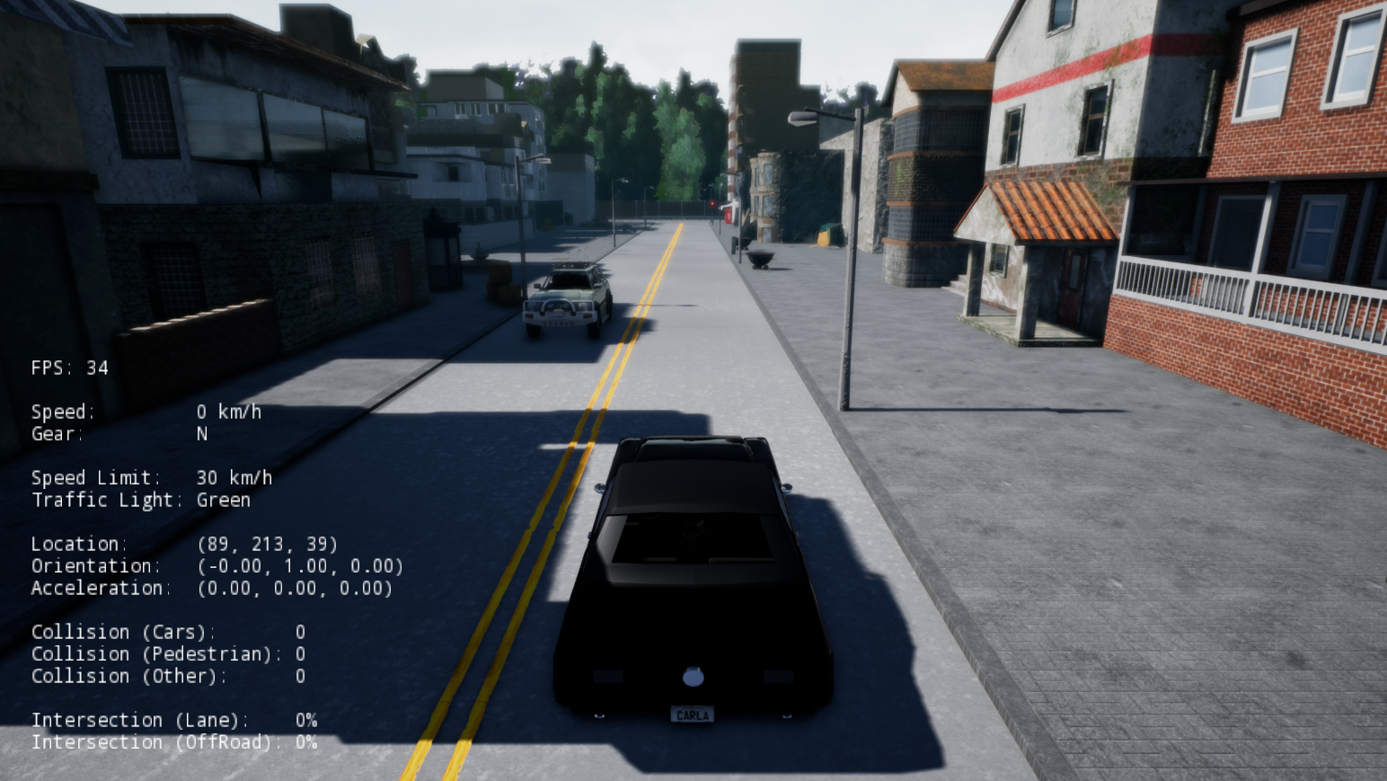
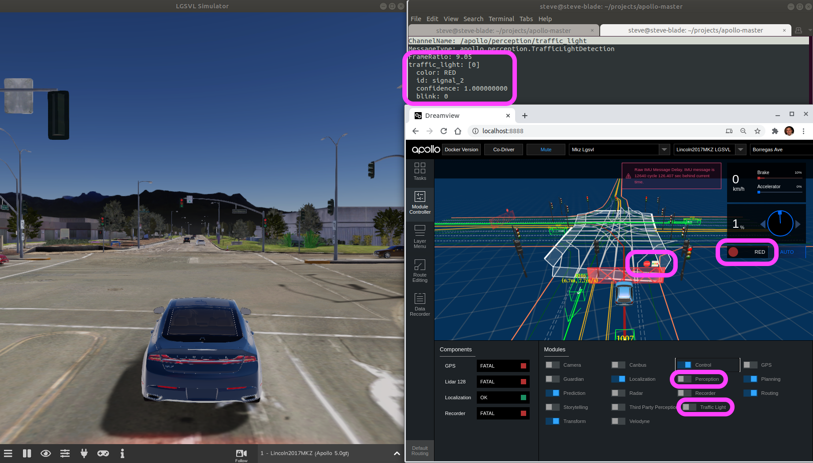
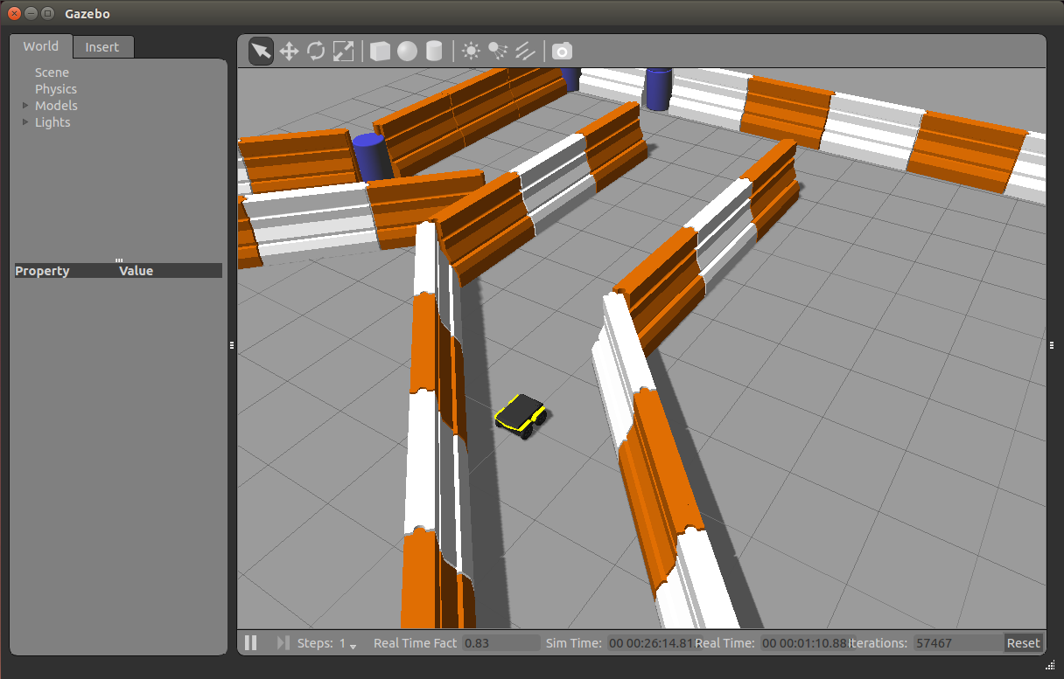
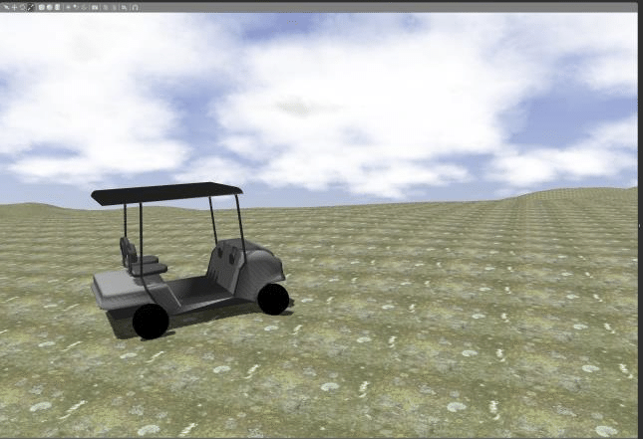
Simulators
Introduction
CARLA
Apollo Baidu
ROS
Gazebo
Notes:
Carla – popular
Complete it not more the 5 minutes
ROS robotics
Gazebo – Custom environment

Slide 7
Content
Introduction
Comparative Study
Parameters
Generative Model based simulators
Results

Slide 8







Problem Statement
Comparative study
What's the most suitable simulator for my application?
Does it align with my requirements?
Is Simulator A better than Simulator B?
How can I compare different simulators ?
Notes:
As a amateur researcher
The proposed approach tries to answer all these question in a systematic way
compare

Slide 9
Why should one compare ?
Comparative study
Numerous simulators exist within the community.
Autonomous driving itself spans across diverse fields.
There are numerous features to take into account.
Specific application needs, like customized environments, must be considered.
Selecting a simulator that best fits the user's requirements is crucial.
Existing Approaches
Domain Specific comparison. [2]
Limited simulators with limited feature comparison table
Notes:
Not all the comparative features are interesting to the user.

Slide 10
Proposed approach
Comparative study
Objective
Establish a unified metric to assess diverse autonomous vehicle simulators' usability.
Approach
Identify 73 discerning parameters from an extensive study of available simulators and their use cases.
Develop a scoring system rating each parameter on a scale of 0 to 1.
Scoring system
Consists of two sets of scores:
User Weight: Measures parameter significance for a user's intended application
Base Score: Evaluates simulator capabilities
Final score combines both sets, offering a comprehensive representation of simulator capability and user preferences. Higher scores indicate a better fit for user needs.
Notes:
A single score
A 73 deciding parameters forms the building blocks.
User weight scored by the user and base score weighed by the developer

Slide 11
Content
Introduction
Comparative Study
Parameters
Generative Model based simulators
Results
Notes:
8 minutes

Slide 12
Parameters
Parameters
Parameters in this work are the criteria that distinguishes different simulators.
The Identified parameters are categorized into 6 categories
2. Actors
3. Environment
4. Ego Vehicle
5. Platform
6. Driving Algorithm
1. Sensors
Parameters
Notes:
Will explain some of the some of the parameters which are not obvious.

Slide 13

1. Sensors
Parameters
Sensors are the tools which used to perceive the environment and vehicle data.
Default sensors
Multiple Synchronous sensors
User defined sensors position and orientation
Precision of sensor readings
Real time sensor models
User- defined sensors and Observers
Notes:
Multiple sync sensor - Explain
Default if needed

Slide 14

2. Actors
Parameters
Actors are the stationary (Buildings, trees) and non stationary (People, cars) objects within the environment. The parameter are further classified into Geometry and behaviour
Geometry | Behaviour
Pre defines Scenarios Predefines models for Actors User-Defined Actors No. of Actors and Spawning Location Recreation of Real time models Path/ destination of Actors Context aware spawning | Pre defined Rules User defined Rules Distinguishable Behavioral pattern Sensitivity Level of aggressiveness in driving Reproducibility
Notes:
Recreation of Real time models, Level of aggressiveness

Slide 15

3. Environment
Parameters
The Environment refers to the setting in which the car operates which includes Map, Weather, Terrain…
Pre defined libraries | User defined scenarios
User defined environments | Material definition
Real world maps | Variable levels of sun shades
Photorealism | Special optical features
Variable resolution | Data visualization and analytical tools
Context aware map-planning | Recording
Notes:
Real world maps – refer summit
User defined scenarios - road repair or fallen tree

Slide 16

4. Ego vehicle
Parameters
The ego vehicle is the vehicle which is subjected to training or testing for autonomous driving within the simulator.
Vehicle Geometry
Wheel Geometry
Real world models
Input commands
Other components
Notes:
Boundry box co-ordinate Horn

Slide 17

5. Platform
Parameters
Platform is the framework within which the simulator operates
Cross platform Compatibility
Open source
Scripting Language support
Scalability
Computation resource evaluation
Community support
Distributed computing
Notes:
Regarding the software
Scaleability – pro and lite , built on top of the base

Slide 18

6. Driving Algorithm
Parameters
Driving Algorithm is the model which is subjected to training or testing, which drives the vehicle within simulator
Data Exchange
Data Logging
Hardware in Loop (HiL)
ML Libraries
Notes:
Algorothim-
Api s client server model

Slide 19

Unified Score
Parameters
Base Scores
Scores
S1
S1
S2
S2
User Weight
$$∗$$
S3
S3
S4
S4
S5
S5
Notes:
5 sim
If a user score 0 for a particular parameter which is not at al important has no influece on the final score

Slide 20
Results
Parameters
Proposed method is validated with 4 different use cases and the result are as follows
 | CARLA | Summit | LGVSL
User 1 | 18.5 |  | 19.7
User 2 | 22.5 | 34
User 3 | 16.65 |  | 22.4
User 4 | 18.4 | 29.2
 | CARLA | Summit | LGVSL
User 1 | 18.5 | 21 | 19.7
User 2 | 22.5 | 34 | 36
User 3 | 16.65 | 23.4 | 22.4
User 4 | 18.4 | 29.2 | 29.7
21
36
23.4
29.7
Scores
User 1 : A university student primarily focused on projects involving sensory data generation, feedback, and training deep learning models. While realism isn’t a top priority, it would be advantageous.
User 2 : A software tester at an automobile company concentrating on validating model performance in real-world scenarios.
User 3 : A research scholar striving to achieve autonomous driving within a confined environment, aiming to replicate real-world custom environments within the simulator.
User 4 : Emphasizes data generation, resembling a data collector preparing datasets, not limited to autonomous driving or ML. Customization options and distributed computing hold importance.
Notes:
Open excel sheet

Slide 21
Challenges
Parameters
Assessing certain aspects of the simulators (Base scores) proves to be challenging such as
Photorealism
Computational recourses
Alternatives
Photorealism → Subjective
Computational recourse → Comparing the power consumption against a baseline system at maximum usage
Notes:
Varies from person to person
Proportional to

Slide 22
Content
Introduction
Comparative Study
Parameters
Generative Model based simulators
Results
Notes:
15 to 18 minutes

Slide 23
Objectives of a simulator
Generative Model based simulators
To Mimic the real world dynamics.
To calculate and simulate the transition in sensor/observation at every timestep for action taken.
Provide realistic sensory data.
Diverse scenario generation.
To Provide feedback to the action taken (Rewards, Penalties)
Notes:
Some of identified objectives of a simulator
End with transition

Slide 24
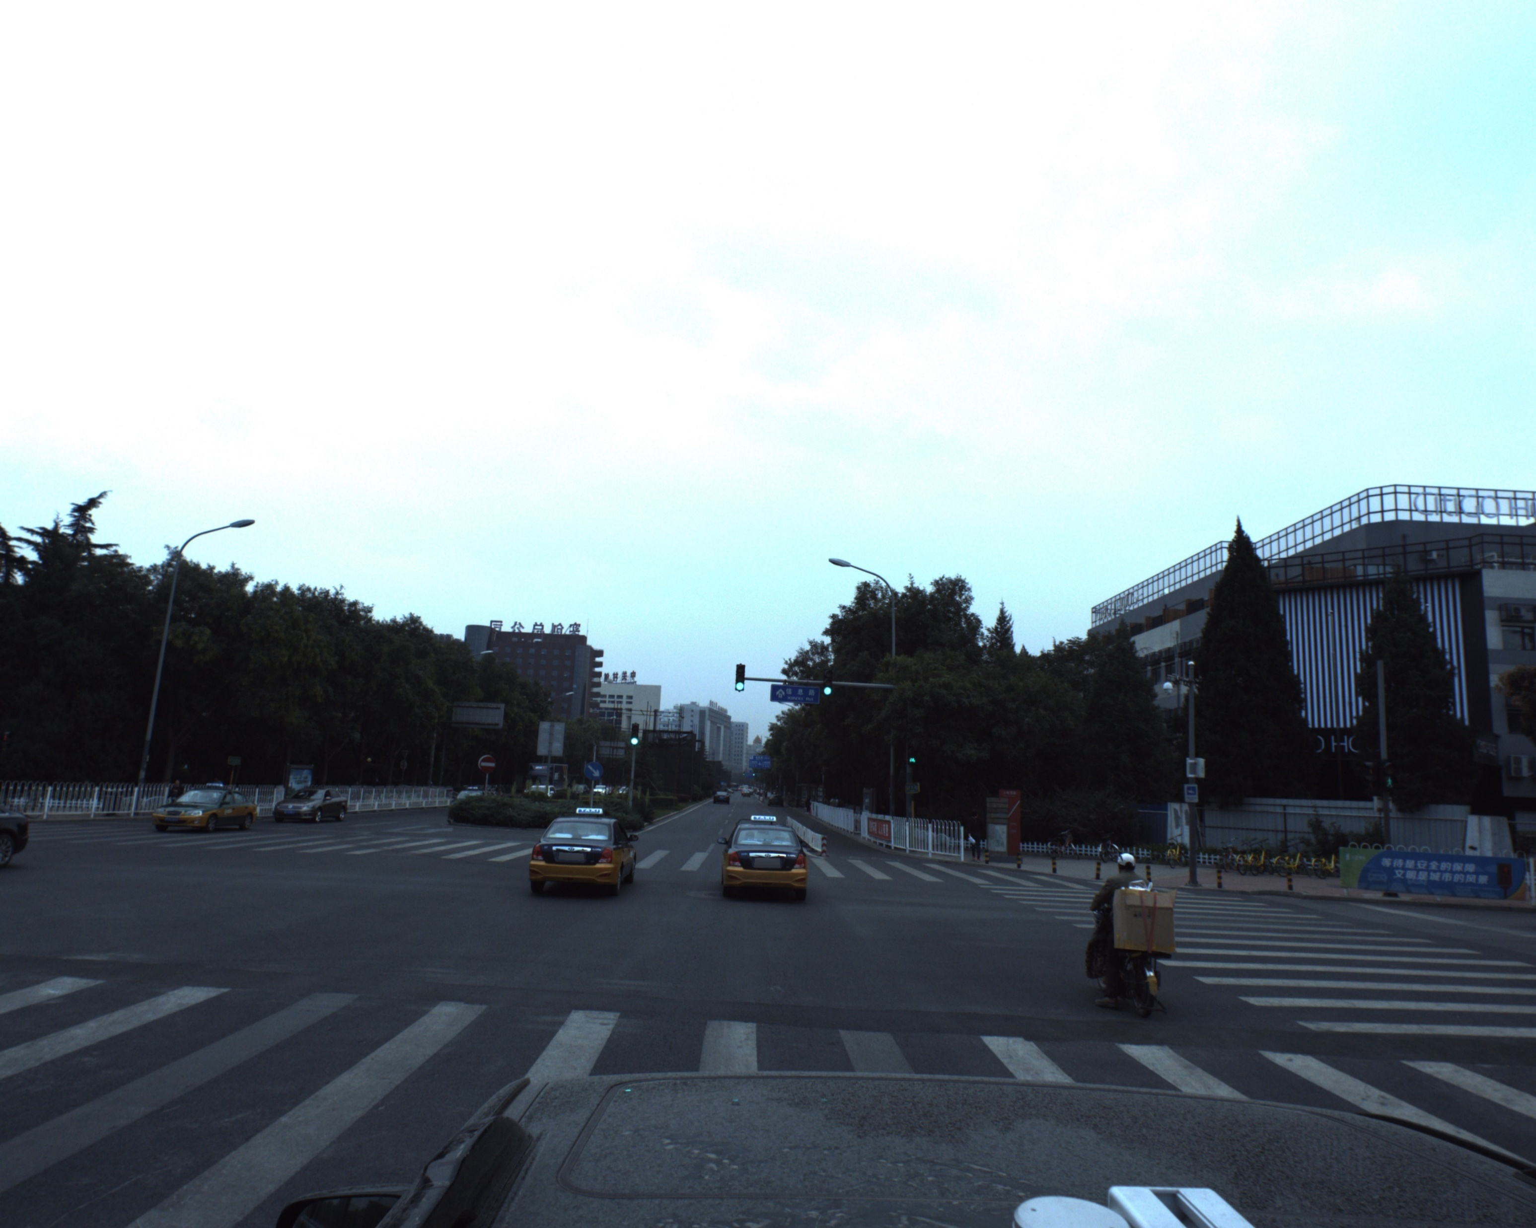
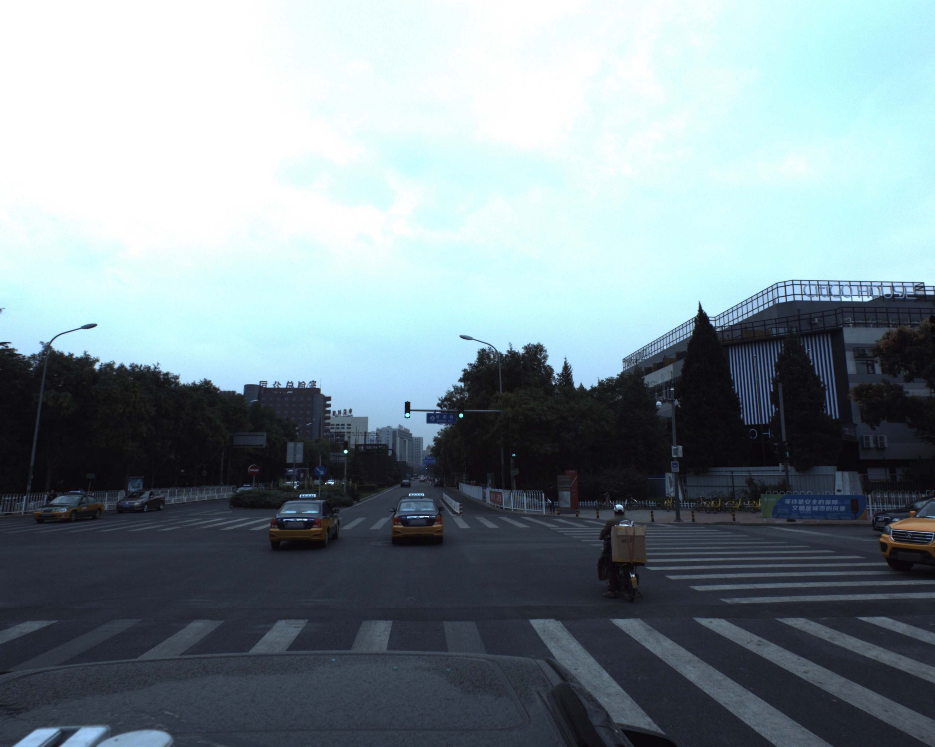
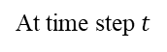
Sensor data transition
Generative Model based simulators
Action:
{
Velocity: 1 unit
Turn angle: 2 degree
Turn direction: Right
}
At time step $t$
At time step t+1
Transition of Image from the camera Mounted on top of the vehicle with respect to action Command
Notes:
Dot say about taxi

Slide 25
Objectives of a proposed simulator
Generative Model based simulators
To Mimic the real world dynamics
To calculate and simulate the transition in sensor/observation at every timestep for action taken.
Provide realistic sensory data.
Diverse scenario generation.
To Provide feedback to the action taken (Rewards, Penalties)
Notes:
Scnario gen emphasis

Slide 26
Sensor data transition
Generative Model based simulators
Action:
{
Velocity: 1 unit
Turn angle: 2 degree
Turn direction: Right
}
At time step $t$
At time step t+1
Transition of Image from the camera Mounted on top of the vehicle with respect to action Command
Notes:
artifacts

Slide 27

Proposed Model
Generative Model based simulators
Simulator
O_{t}
O_{t}
O_{t}
Generator
Generator
O_{t+1}
Agent
O_{t+1}
Action
Action
Simulator
O_{t+1}

Slide 28
Proposed Model
Generative Model based simulators
O_{t}
Generator
O_{t+1}
Action
The Proposed Simulator will generate the sensory data for next timestep O_{t+1} for given current timestep O_{t} and action taken at that time step.
The generated data is fed back into the generator with an action command recursively.
The generated data should be plausible and able to generate some new objects within the Generated sensory data.
Notes:
Recursive chain
Ot+1 should have some artifacts and should be carry forwarded to consecutive observation

Slide 29
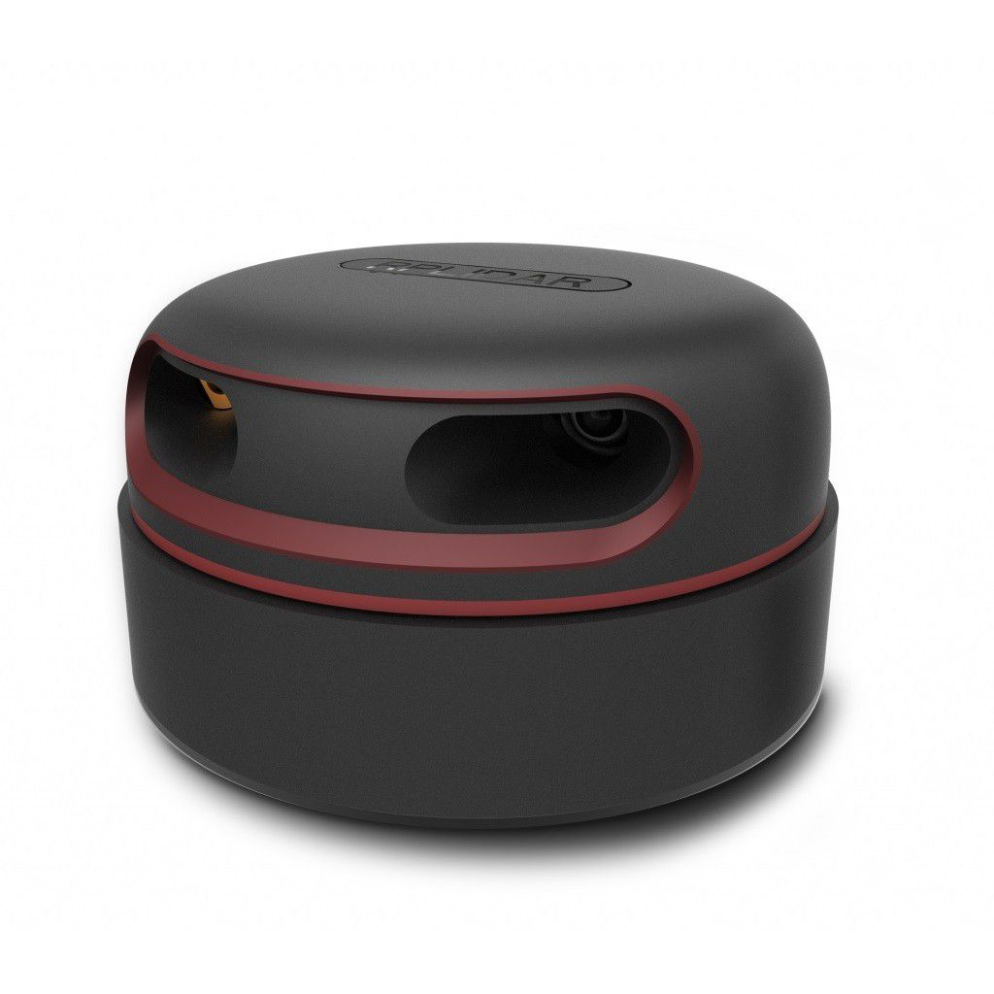
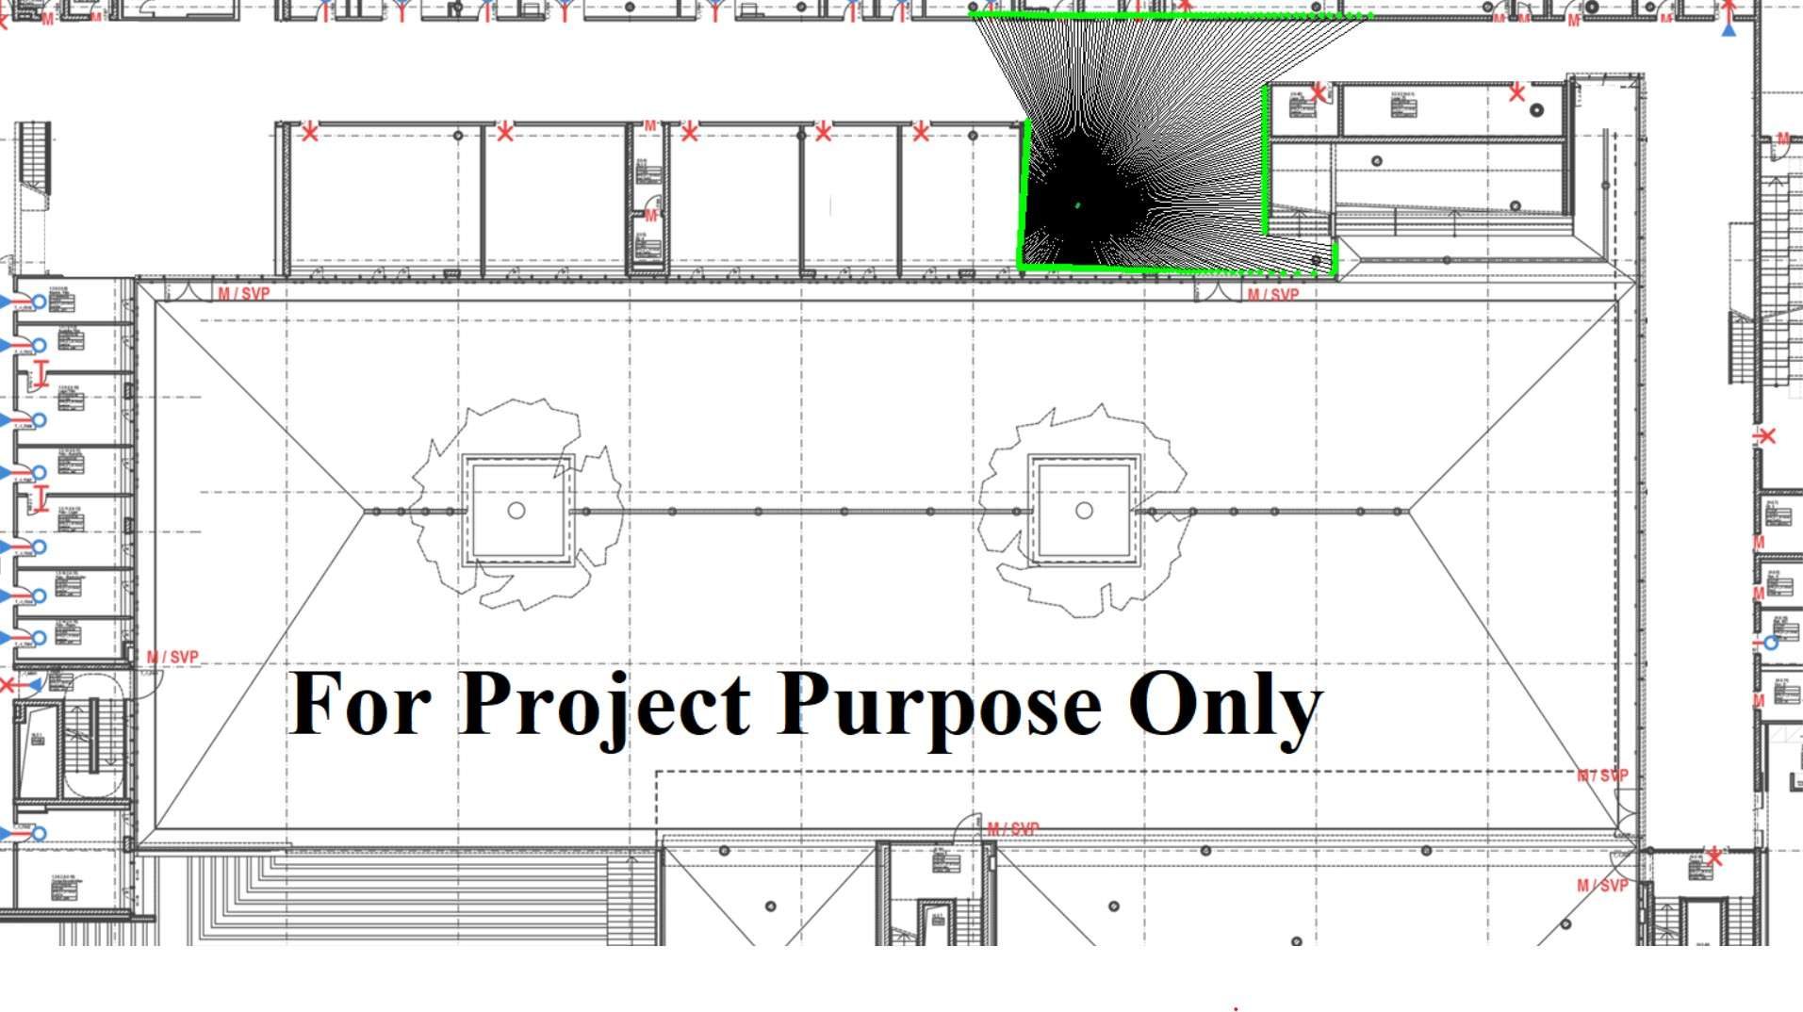
Training Dataset
Generative Model based simulators
Requires substantial amount of data to train a Generative model
No action label
Computational power for Images
Proposed Alternative
Using simple dataset that resemble 2D Lidar data
Data synthesized from a mathematical model based simulator with Labels (action vector)
Notes:
Mathematical model of This hardware RP lidar A3

Slide 30
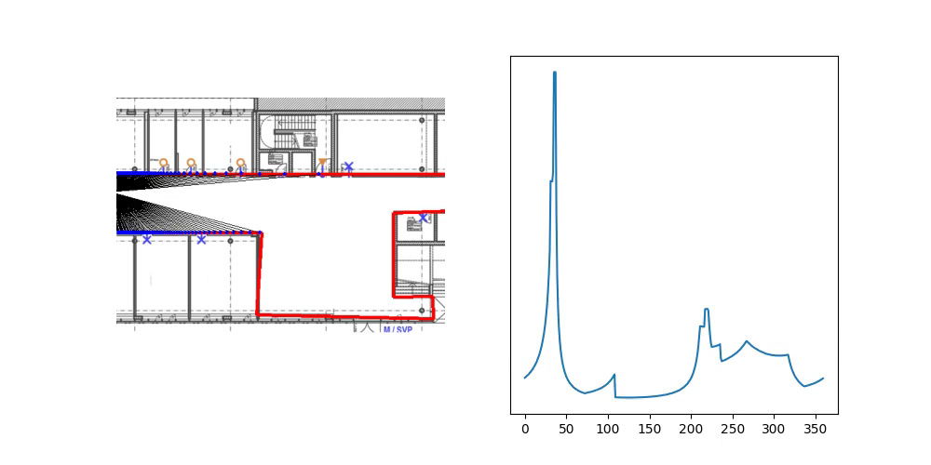
Mathematical model based simulator
Generative Model based simulators
Angle
Notes:
Peaks corresponds to longer distance
Blind spot set to 0
Gaussian noise
Random drop

Slide 31
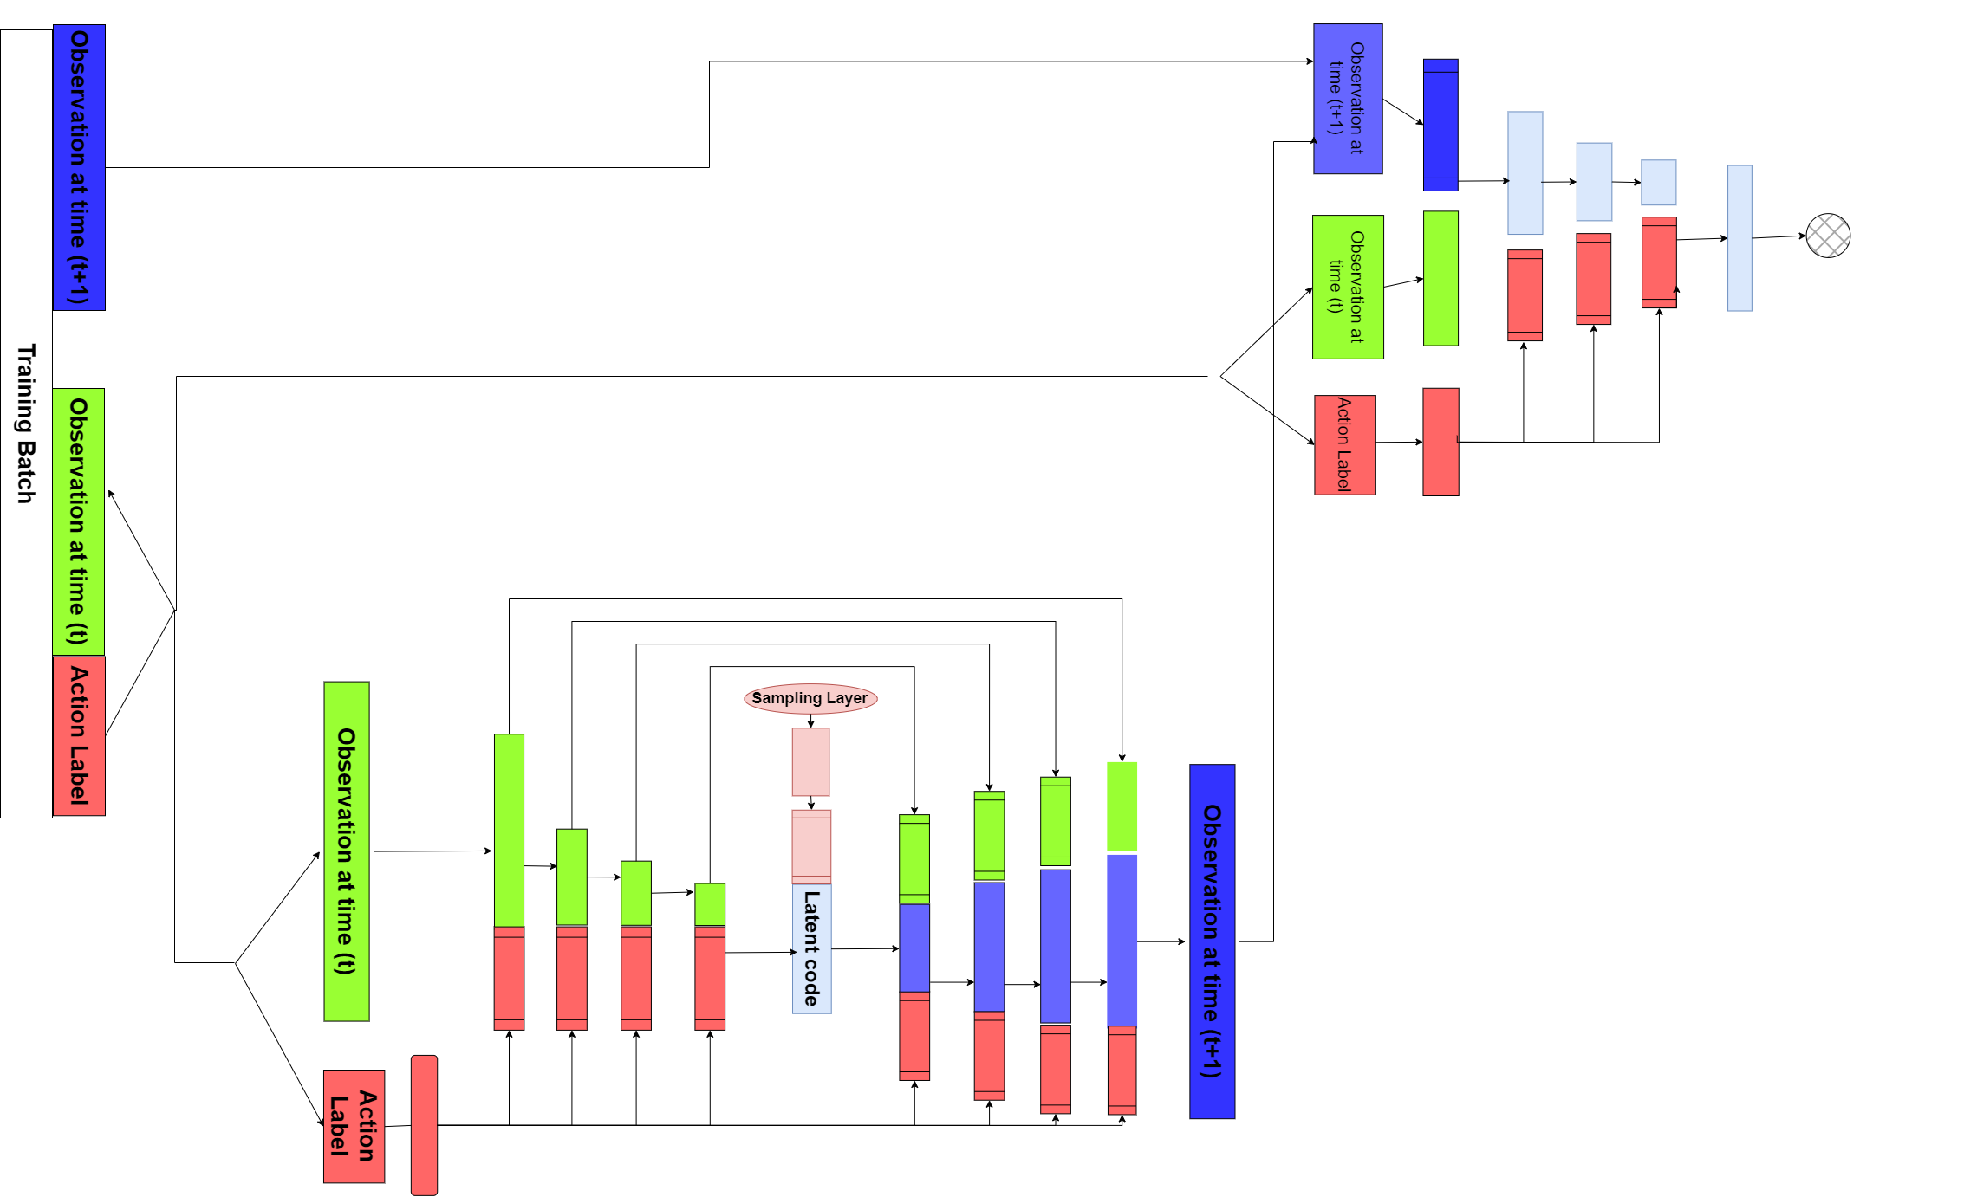
Conditional GAN
Generative Model based simulators
Generator
Notes:
Sampling layer passes through a gate
U nets
Action command propagated through a fully connected net s concatenated to every layers

Slide 32
Conditional GAN
Generative Model based simulators
Real/Fake
Generator
Discriminator
Notes:
Click once again for arrows

Slide 33
Content
Introduction
Comparative Study
Parameters
Generative Model based simulators
Results
Notes:
25 minutes

Slide 34
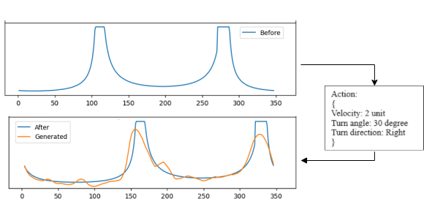
Results
Generative Model based simulators
Notes:
Don’t infere

Slide 35
Results
Generative Model based simulators
Successful transition of sensor data in concordance with the action commands
Noise is observed in the generated data
No new features are identified within the generated data
Notes:
Refer back to video if needed for perks

Slide 36
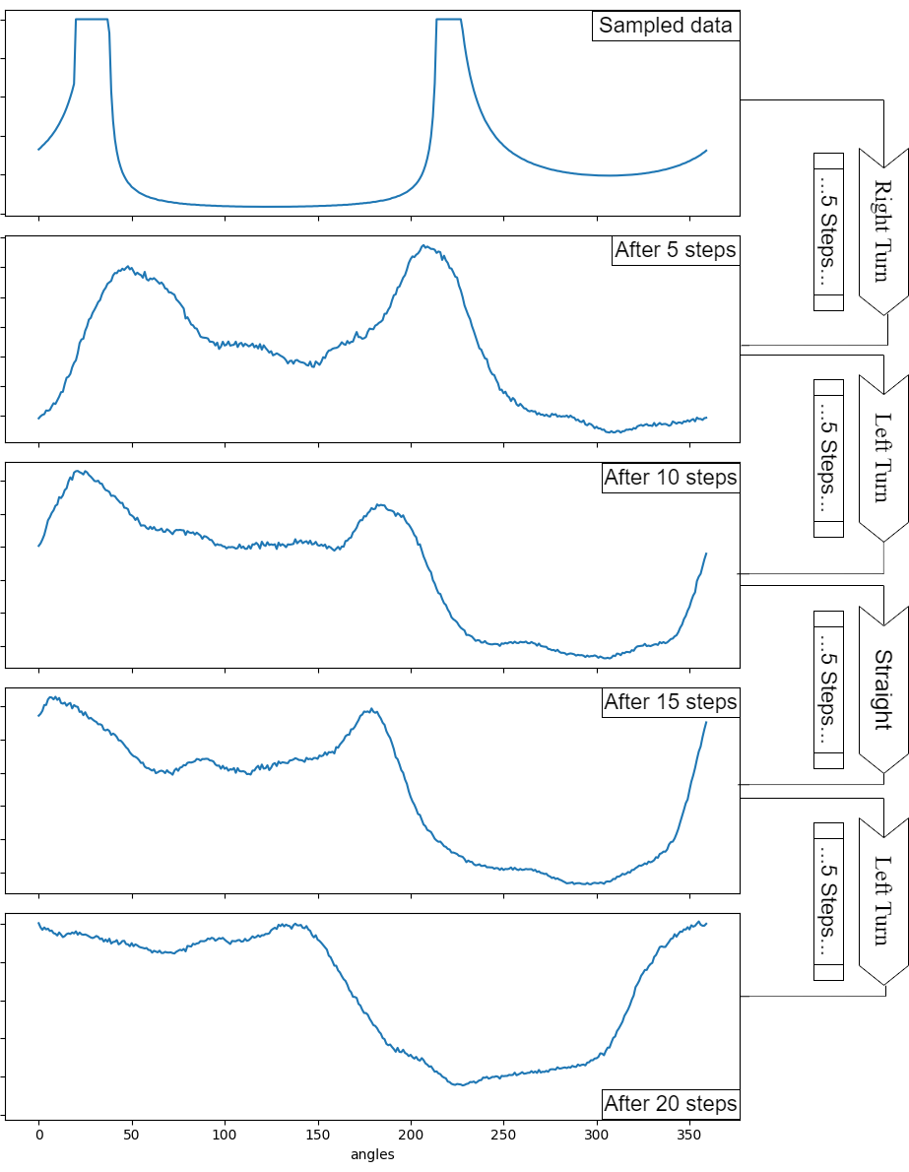
Results
Generative Model based simulators
Notes:
Low pass filters to reduce noise

Slide 37
Conclusion and Future works
Comparative study
Comparative Evaluation
A systematic evaluation method for comparing simulators employed in the field of autonomous vehicles has been proposed.
This approach estimates the useability of a simulator using a unified score which takes both simulator’s capabilities and user’s interest into consideration.
Future works
Mandatory Parameter – Excluding a simulator from the comparative process if it fails to meet specific parameter could shorten the evaluation time.
Supplementary Parameters – Adding or removing parameters based on survey findings could enhance the system's usability.

Slide 38
Conclusion and Future works
Generative Model based simulators
Generative model based simulators
A concept of simulators employed for autonomous driving based on Generative models has been proposed.
A prototype simulator which simulates 2D lidar data driven by a conditional GAN trained on a synthesised data has been realised.
Future works
Real Data – Training the suggested model with real data could enhance its diversity and prevent mode collapse.
Image dataset– Validating the generation of realistic and diverse scenarios can be effectively done using image datasets.
Synchronous Sensors – Utilizing training data that includes information from multiple sensors could assist in learning the correlation between these sensors.
Notes:
Synchronous Sensors could gen sync data

Slide 39
Thank you for your attention!!

Slide 40

Thank you for your attention!!
Questions
Notes:
ref

Slide 41
References
https://www.sae.org/blog/sae-j3016-update
Yang, G., Xue, Y., Meng, L., Wang, P., Shi, Y., Yang, Q., & Dong, Q. (2021, August). Survey on autonomous vehicle simulation platforms. In 2021 8th International Conference on Dependable Systems and Their Applications (DSA) (pp. 692-699). IEEE.
Dosovitskiy, A., Ros, G., Codevilla, F., Lopez, A., & Koltun, V. (2017, October). CARLA: An open urban driving simulator. In Conference on robot learning (pp. 1-16). PMLR.
Koenig, N., & Howard, A. (2004, September). Design and use paradigms for gazebo, an open-source multi-robot simulator. In 2004 IEEE/RSJ international conference on intelligent robots and systems (IROS)(IEEE Cat. No. 04CH37566) (Vol. 3, pp. 2149-2154). IEEE.
https://developer.apollo.auto/platform/simulation.html
https://waymo.com/
https://zoox.com/

Slide 42
Default sensors
A simulator which supports these sensors will receive a score 1 for each or 0 otherwise.
RGB Camera
Depth Camera
3D Lidar
Radar
IMU Sensor
Semantic info Sensor
Force Impact Sensor
Lane detection/ infringement sensor
Fuel/ Battery sensor
Vehicle speed sensor
GPS
Visibility Sensor
Other vehicle sensors related to vehicle dynamics
Other environment sensors related to perception
Macroscopic Global Sensor
Back
Notes:
Not a physical sensor

Slide 43
Platform 1
Cross Platform Compatibility | Scripting Language | Community support
Linux ROS Windows MacOS Others | Python C++ R+ Java Others | Structured Documentation Tutorials Discussion Forums
Others represents any other platforms or languages which the user is interested in.
Back

Slide 44
Baseline system
Component | Model | Power Consumed (at max usage.)
Processor | Intel i9 processor | 200 – 250 Watts
GPU | Nvidia RTX 3090 – 24 Gb | 400 Watts
RAM and Disk | 16 Gb and 500 Gb SSD | 15 Watts
Monitor | 27” 4K resolution Monitor | 50 Watts
Fan and other components |  | 25 Watts
Total |  | 750 watts (approx.)
Back
Notes:
Average PC configuration for AI researchers

Slide 45
Mathematical model based simulator
How it works? (Briefly)
Initiate a Random Environment (Artificial Walls and Obstacles)
Randomly place the vehicle in the environment
Observe the Environment at time t
Take a random action defined by 3d Vector {Turn Direction, Turn Angle, Velocity}
Observe the environment at time t+1
Store the data as {Observation at t, Action taken, Observation at time t+1}
_________________________________________________________________________________
What is Observing means?
Calculate distance of the closest intersection point (Cramer’s Rule) with respect to vehicle centre at every angles (0 to 359)
back

